Slide 1
Section 2.3 Calculating Limits Using the Limit Laws
Lecture 1
Math strategy and rigor

Slide 2
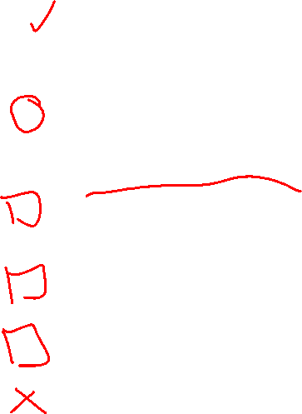
Homework Submission to Canvas
Preview of section
Skim the section in text and write a short paragraph summary.
Give a bulleted list of all important definitions, theorems, and formulas without details.
Notes on video lectures
Take notes on everything written on slides including all details, worked examples, on-own activities, as well as your own thoughts and questions.
Try on-own activities first, then write down provided solution next to it for comparison.
Worked examples from the text
Write down the problem and attempt without looking at the solution.
Use the solution to write the best explanation you can.
Solutions to textbook exercises
Model approaches and explanations given in the video lectures and textbook examples.
Final reflection of section
List the key takeaways to remember as a bulleted list.
Video reflection (for some sections)
Write a 1 paragraph reflection on the video discussing what you found most interesting or useful.

Slide 3
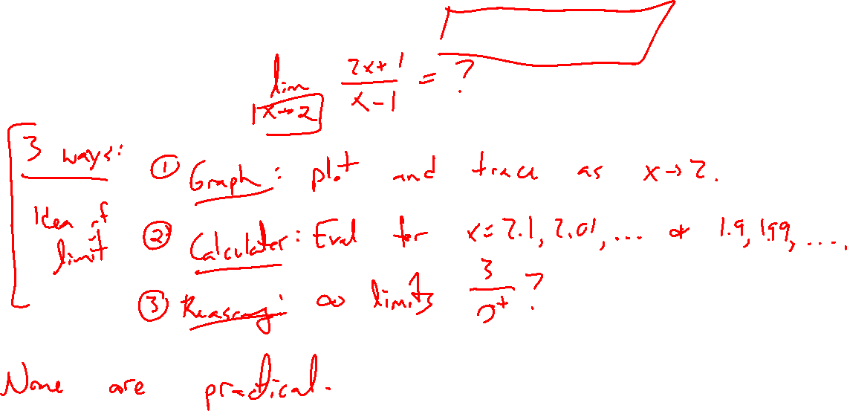
Recap: Limit calculation techniques
Notes:
3 ways so far: Ex f(x) = (x+1)/(x+1)
- graph (imprecise, unreliable)
- calculator (impractical, not intuitive)
- reasoning (fuzzy)
Need a precise approach for any functoin f(x)

Slide 4
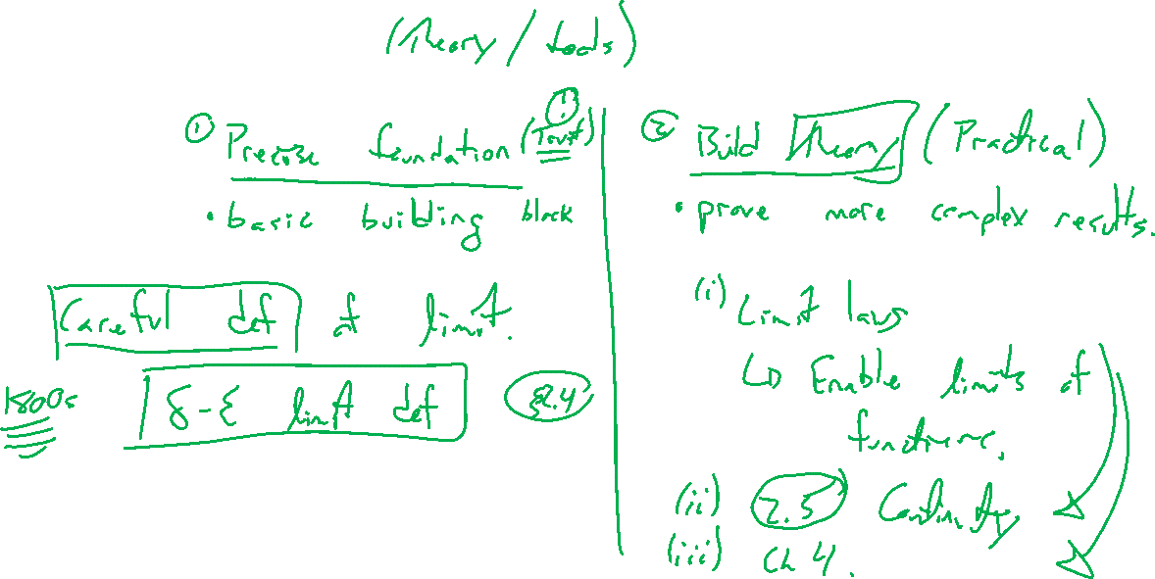
Way of math
Notes:
Precise foundation: \delta-\epsilon def of limit (next section, short version)
Build theory: Limit laws foundation, combine to compute limits of many functions

Slide 5
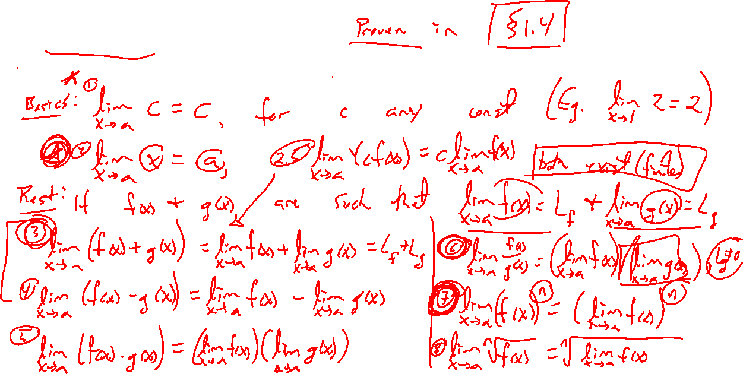
Theorem: Limit Laws
Notes:
Basics: lim_{x \rightarrow a} c = c, lim_{x \rightarrow a} x = a
Level up: If both limits exist (right and left agree, are finite, important)
- f+g, f-g, cf(x), f \cdot g, f/g (avoid zero div), f^n, \sqrt[n]{f(x)}
Tool of next section prove these carefully, for now they seem reasonable and we trust them

Slide 6
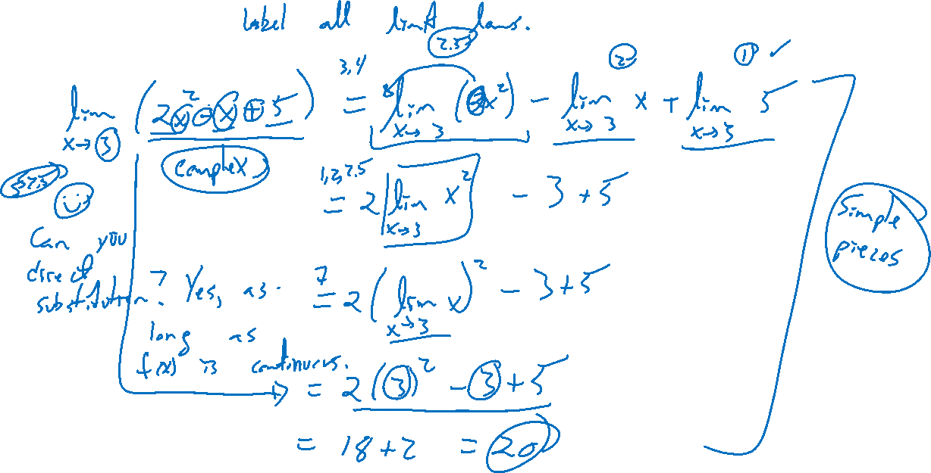
Example:
Notes:
Limit of random quadratic
Label all limit laws invoked
Note, in this case, same as computing f(a). Will address this in section 2.5

Slide 7
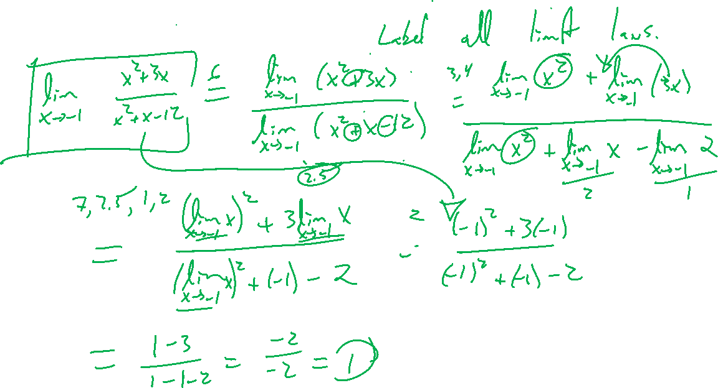
Example: Try on own
Notes:
Label limit laws used
Lim_{x \rightarrow –3} (x^2+3x)/(x^2-x-12)
Removable discontinuity, need to simplify first. Not can cancel without worry because of limit location.
Check in Desmos.

Slide 8
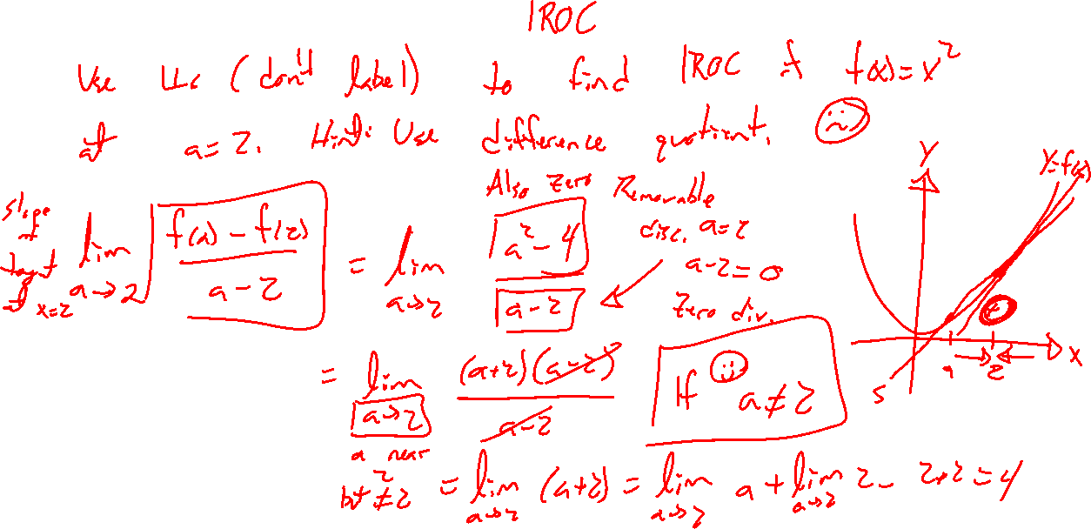
Example: Try on own
Notes:
Return of IROC
Compute the IROC of f(x)=x^2 at x=2. Use x=a and a\rightarrow 2

